Slide 1
CSS 3 - Assignment

Slide 2


Slide 3
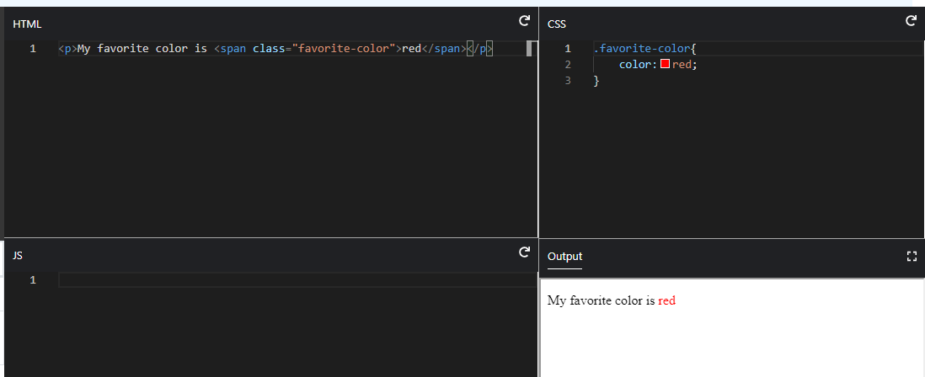

Slide 4
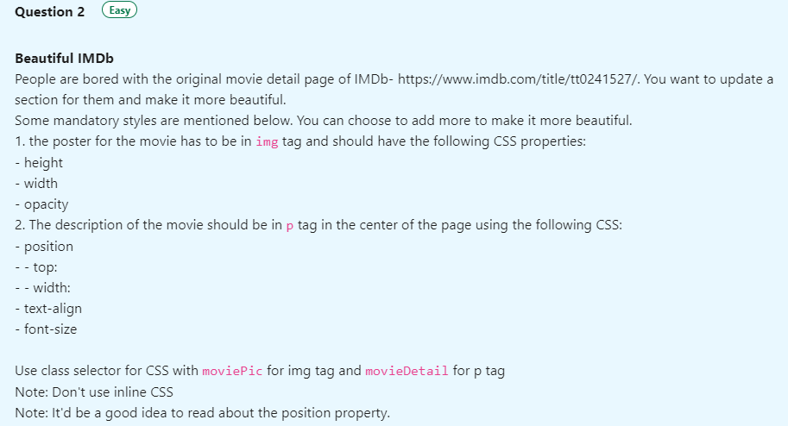

Slide 5


